Slide 1
Data Science Capstone project
Bui Duc Cuong
18 AUGUST 2021

Slide 2

Outline
Executive Summary
Introduction
Methodology
Results
Conclusion
Appendix

Slide 3

Executive Summary
This project collects data from SpaceX website and Wiki to build a predictive model whether a rocket will launch successfully or not.
We plots many chart for a better view and tests many predictive classifications (K-Nearest Neighbor was the best for our problem)

Slide 4

Introduction
Project background and context
The commercial space age is here, companies are making space travel affordable for everyone. Virgin Galactic is providing suborbital spaceflights. Rocket Lab is a small satellite provider. Blue Origin manufactures sub-orbital and orbital reusable rockets. Perhaps the most successful is SpaceX. In this capstone, I will take the role of a data scientist working for a new rocket company.Space Y that would like to compete with SpaceX founded by Billionaire industrialist Allon Musk
Problems you want to find answers
Determine the price of each launch
Determine if SpaceX will reuse the first stage

Slide 5

Methodology
Data collection methodology:
Data was requested from SpaceX website (for information of launches) and scraping from Wiki (for results of each launch)
Perform data wrangling
Change type of some colums, replace missing data with mean, change all independent variable using one-hot encoding
Perform exploratory data analysis (EDA) using visualization and SQL
Perform interactive visual analytics using Folium and Plotly Dash
Perform predictive analysis using classification models
Perform predictive analysis using classification models, how to build, tune, evaluate classification models

Slide 6
Methodology

Slide 7
Data collection
Request rocket launch data from SpaceX API and save in a dataframe
Take subset of features that we need
Reformat some features and limt dates of launches
Create a dict with all features names that we want as keys
Use given function to extract date from above dataframe to our dict
Convert dict to dataframe and save as .CSV file for next step

Slide 8
Data collection – Web scraping
Extract titles and names of columns
Create dict with those columns and some extra columns
Loop thru tables and each row in table and add rows to above dict
Change dict to dataframe and save as .CSV file for next step

Slide 9
Data wrangling
Check for number of nulls and types of each cloumn
Count values of each launch site and types of Orbit for better understanding of our dataset
Create landing outcome label for Outcome column with 0 for failure and 1 for success mission
Save datafame as .CSV file for next step

Slide 10
EDA with data visualization
Bar chart was plotted to have visually check between many types of a variable affecting success rate
Scatter plot was plotted to visually see correlation between two variables
Line chart was plotted to see how one variables was changing

Slide 11
EDA with SQL
Its purpose to have better way for understand of our dataset
Qurried to have names of all unique launch sites, sort our dataset with many condition such as:
Payload mass carried boosters launch by NASA
Launch site contain with string ‘CCA’
Average payload mass of booster Version F9 v1.1
List the date of first successful landing outcome in ground
Name of boosters which have success landing in drone ship and have payload greater than 4,000 and less than 6,000 kg
Total number if successful and failure mission outcome
Name of booster Versions which have carried the max pay load mass
Months, booster versions and launch site of failure landing in drone ship in 2015
Rank the count of success landing outcome from 2010-06-04 and 2017-03-20

Slide 12
Build an interactive map with Folium
Circle marker was added to mark location of all launch site
Cluster Marker was add to see total number of launchs of each site and label success and failure launchs when clicking into each site on map
Marker was added to mark proximities of each site and polyline was added to conncet a certain proximitie to launch sites, label by distance in km

Slide 13
Build a Dashboard with Plotly Dash
A pie chart to show total successful launches count for all sites or show failure and success mission if specific launch site was selected
A scatter plot to show correlation between payload mass (kg) and success rate
Pie chart is a good way to show total for all launches and scatter plot also good for showing correlation. Interactive plot can change range of payload mass to give us a better look in which payload mass may perform best.

Slide 14
Predictive analysis (Classification)
+ Use Y-set from class of dateset from part 2
+ Use X-set of all one-hot encoding features from dataser part 3
+ Convert target set (Y-set) to numpy object
+ Standardize date in X
+ Split out dataset into train set and test set
+ Choose best parameters and fit 4 model
+ Calculate accuracy for each model using method score
+ View confusion matrix of each produced

Slide 15
Results
Exploratory data analysis results
Interactive analytics demo in screenshots
Predictive analysis results

Slide 16
EDA with Visualization

Slide 17
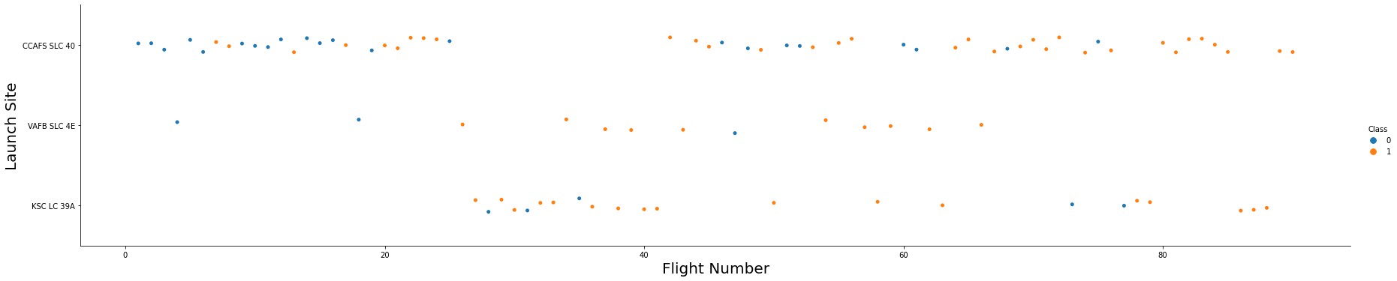
Flight Number vs. Launch Site
We can see the number of flights for each launch sites

Slide 18
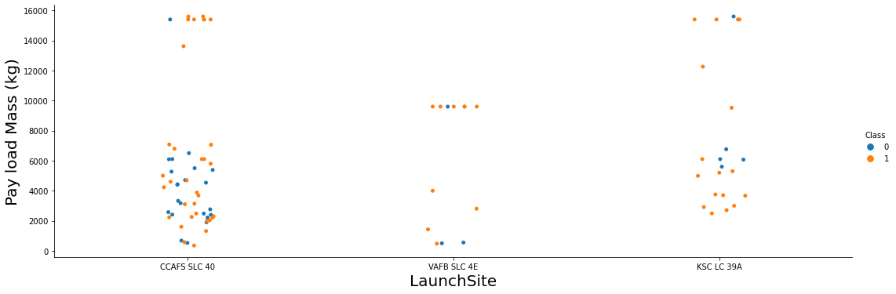
Payload vs. Launch Site
We can see the payload mass of each launch sites

Slide 19
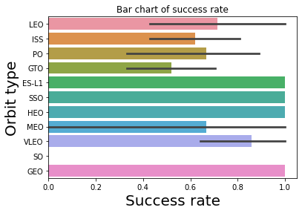
Success rate vs. Orbit type
We can see the success rate of each orbit type

Slide 20
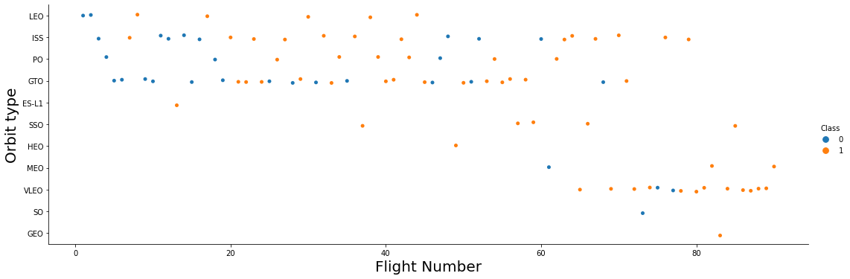
Flight Number vs. Orbit type
We can see the relationship between the number of filghts and the orbit type

Slide 21
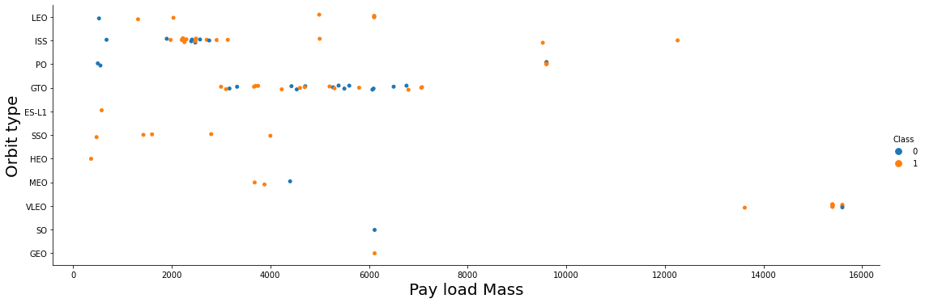
Payload vs. Orbit type
We can see the orbit type and payload mass on the graph

Slide 22
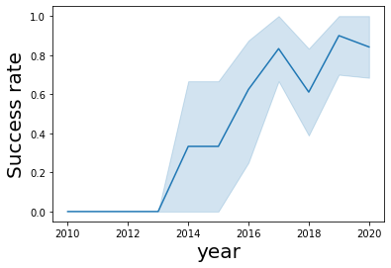
Launch success yearly trend
We can see an increasing trend from 2013 to 2020. But in 2018, the trend has decreased

Slide 23
EDA with SQL

Slide 24
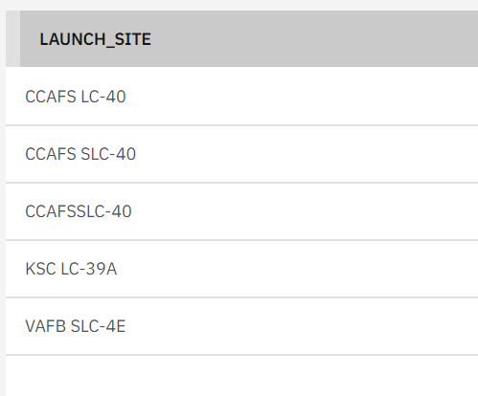
All launch site names
Here is my query to show the names of the launch site below:
select Launch_Site from SPACEXTBL
group by Launch_Site;

Slide 25
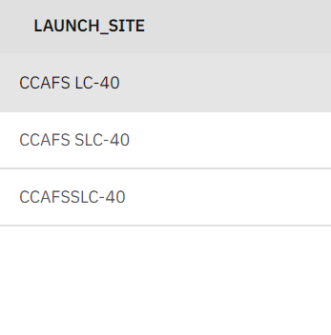
Launch site names begin with `CCA`
Here is my query to Find all launch sites begin with `CCA below:
select DISTINCT Launch_Site from SPACEXTBL
where Launch_Site like 'CCA%' ;

Slide 26
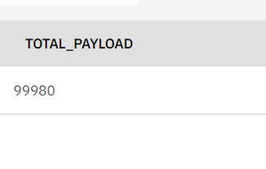
Total payload mass
Here is my query to Find all launch sites begin with `CCA below:
select SUM(PAYLOAD_MASS__KG_) as total_payload from SPACEXTBL
where CUSTOMER like 'NASA%';

Slide 27
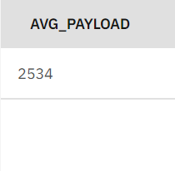
Average payload mass by F9 v1.1
Here is my query to Calculate the average payload mass carried by booster version F9 v1.1 below:
select AVG(PAYLOAD_MASS__KG_) as AVG_PAYLOAD from SPACEXTBL
where BOOSTER_VERSION like 'F9 v1.1%';

Slide 28
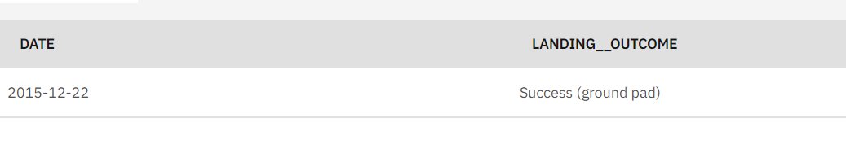
First successful ground landing date
Here is my query to Find the date when the first successful landing outcome in ground pad:
Firstly, I find all the first date in landing outcome (all the status)
select min(date) AS DATE, LANDING__OUTCOME FROM SPACEXTBL
GROUP BY LANDING__OUTCOME;
Finally, I choose the successful landing outcome in ground pad to take the results

Slide 29
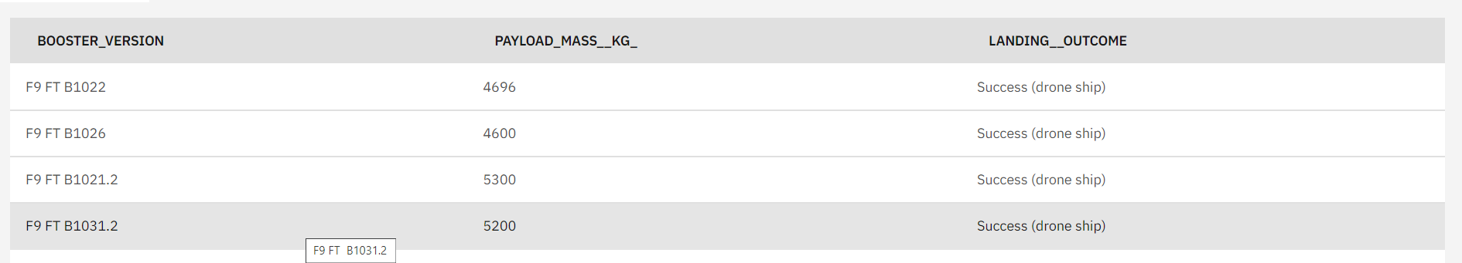
Successful drone ship landing with payload between 4000 and 6000
My Querry below:
select BOOSTER_VERSION, PAYLOAD_MASS__KG_, LANDING__OUTCOME from SPACEXTBL
Where PAYLOAD_MASS__KG_ > 4000 and PAYLOAD_MASS__KG_ <6000 and LANDING__OUTCOME = 'Success (drone ship)';
There are 4 versions of the missile F9 that qualified. I used where clause and condition ‘and’.

Slide 30
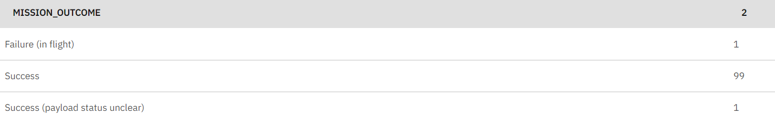
Total number of successful and failure mission outcomes
Calculate the total number of successful and failure mission outcomes
select distinct(mission_outcome), count(*) from SPACEXTBL
group by MISSION_OUTCOME;

Slide 31
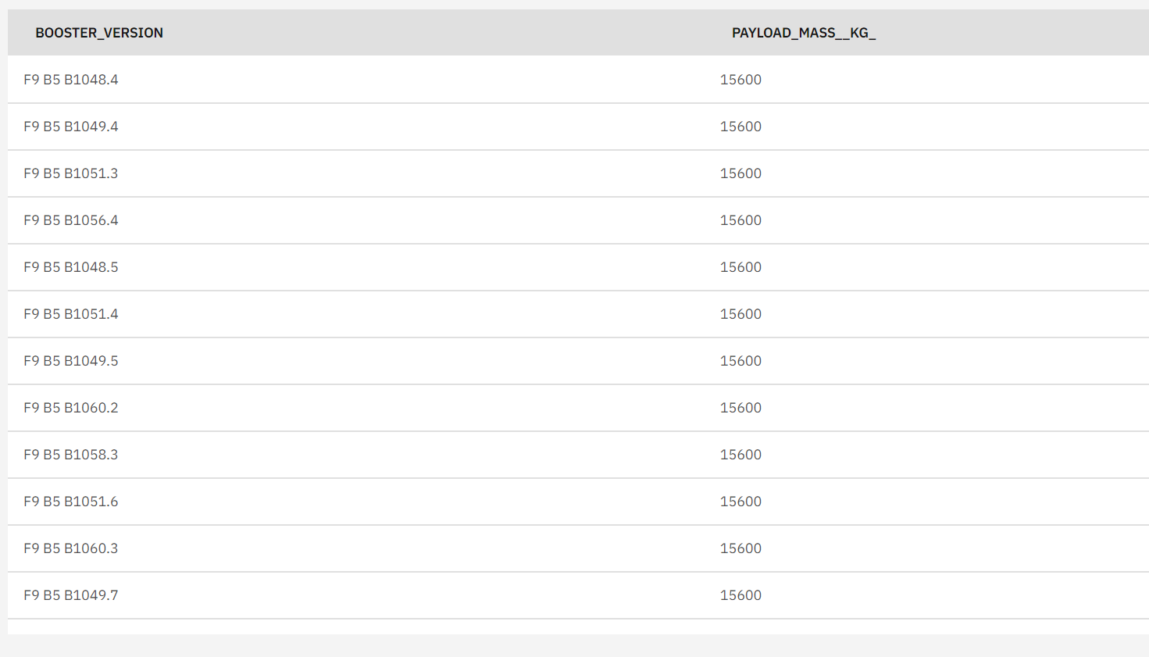
Boosters carried maximum payload
My Querry below:
Select BOOSTER_VERSION,
PAYLOAD_MASS__KG_ from SPACEXTBL
WHERE PAYLOAD_MASS__KG_ =
(SELECT MAX(PAYLOAD_MASS__KG_) from SPACEXTBL);
There are total of 12 Version of the F9 that have carried a weight of 15,600 kg. I used sub-querry (SELECT MAX(PAYLOAD_MASS__KG_) from SPACEXTBL) to find the maximum of the payload

Slide 32
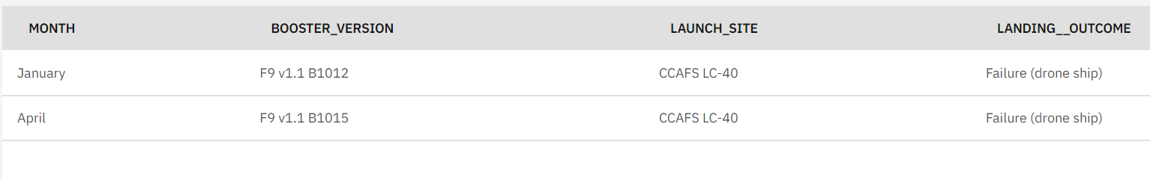
2015 launch records
List the records which will display the month names, failure landing_outcomes in drone ship ,booster versions, launch_site for the months in year 2015, and my querry below:
select MONTHNAME(DATE) AS MONTH, BOOSTER_VERSION, LAUNCH_SITE, LANDING__OUTCOME from SPACEXTBL
WHERE LANDING__OUTCOME like 'Failure (drone ship)' and YEAR(DATE)=2015;

Slide 33
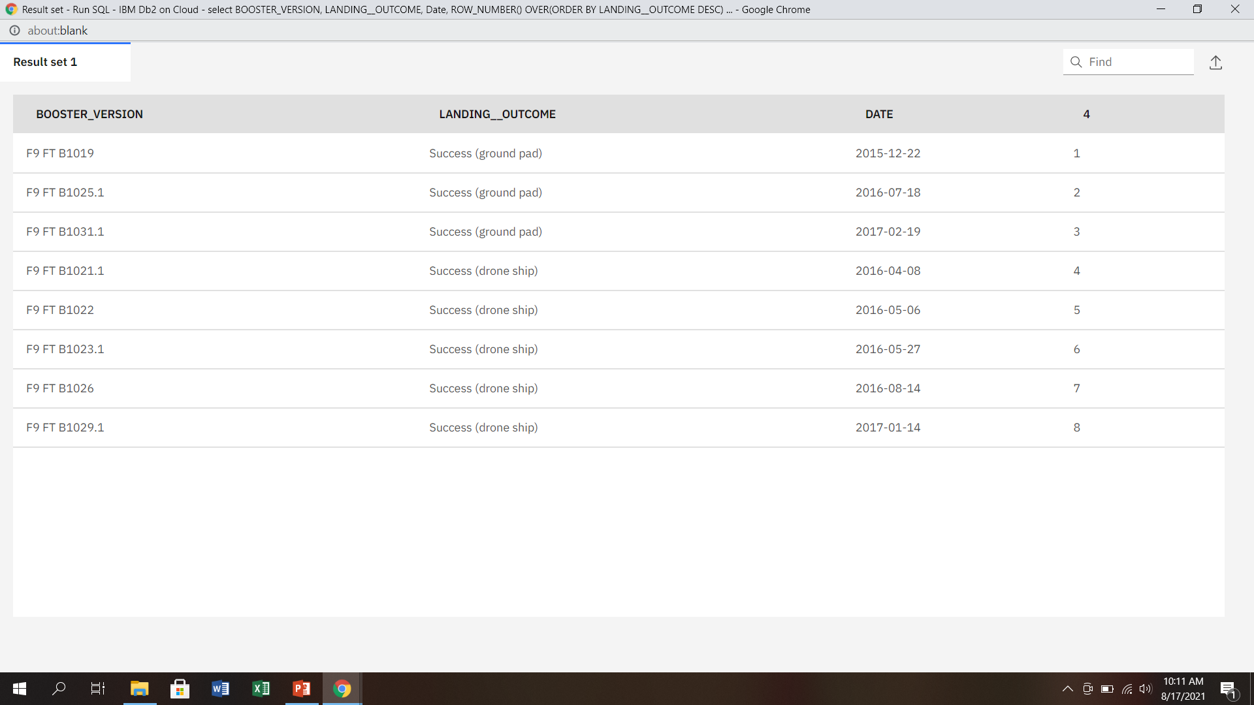
Rank success count between 2010-06-04 and 2017-03-20
Rank the count of successful landing_outcomes between the date 2010-06-04 and 2017-03-20 in descending order below:
select BOOSTER_VERSION, LANDING__OUTCOME, Date,
ROW_NUMBER() OVER(ORDER BY LANDING__OUTCOME DESC) FROM SPACEXTBL
WHERE LANDING__OUTCOME like 'Success%' and date between '2010-06-04' and '2017-03-20';

Slide 34
Interactive map with Folium

Slide 35
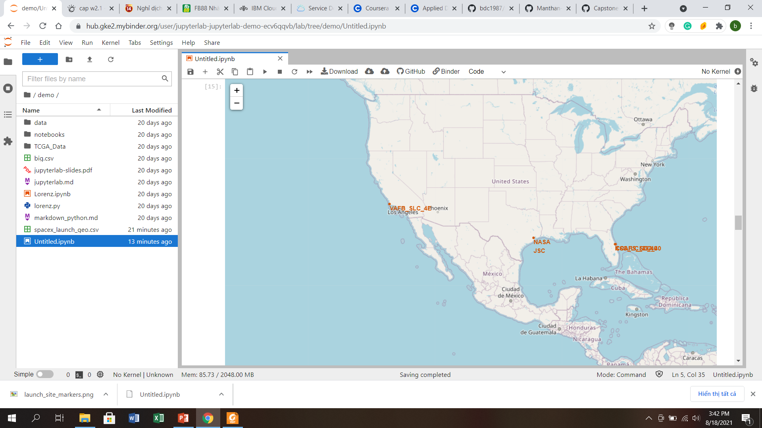
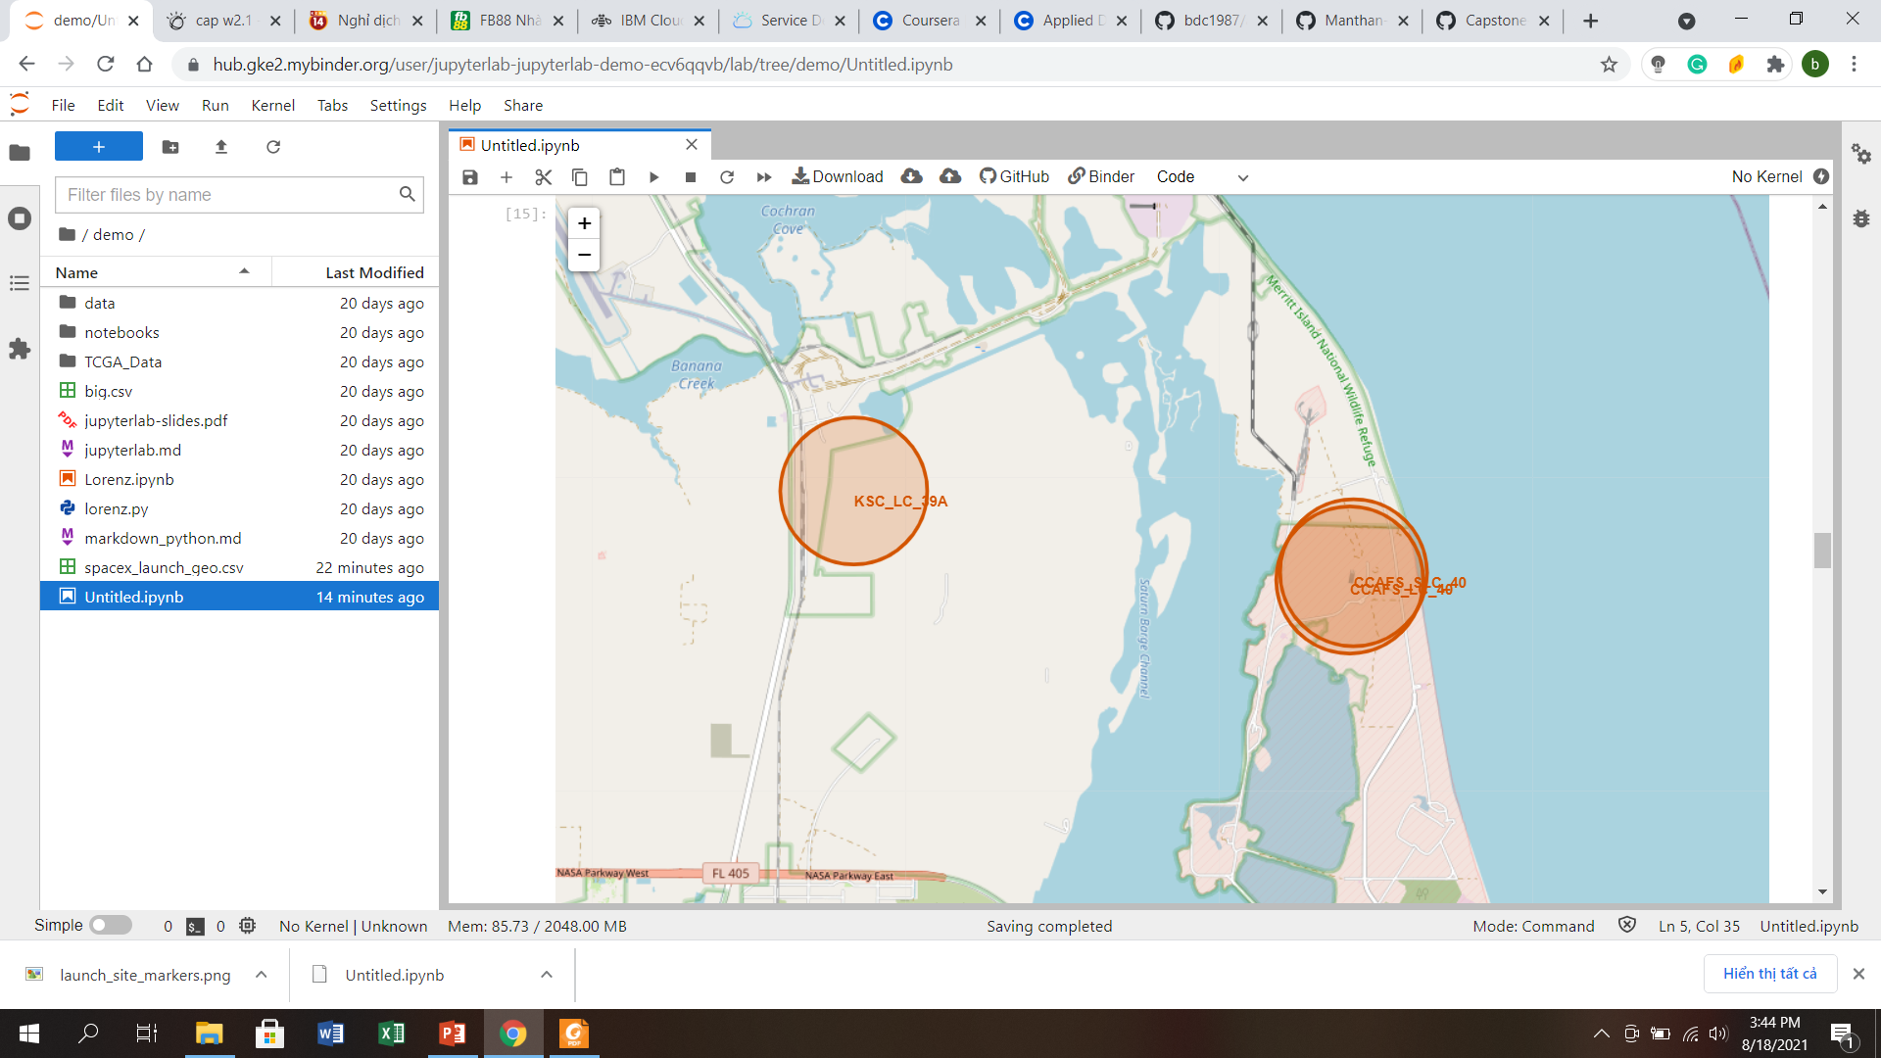
Locations of all Launches Sites
We can easily see all locations all launch sites on the left map by red circle with name of each launch site
Zoom in to see clearly each launch site located by a red circle

Slide 36
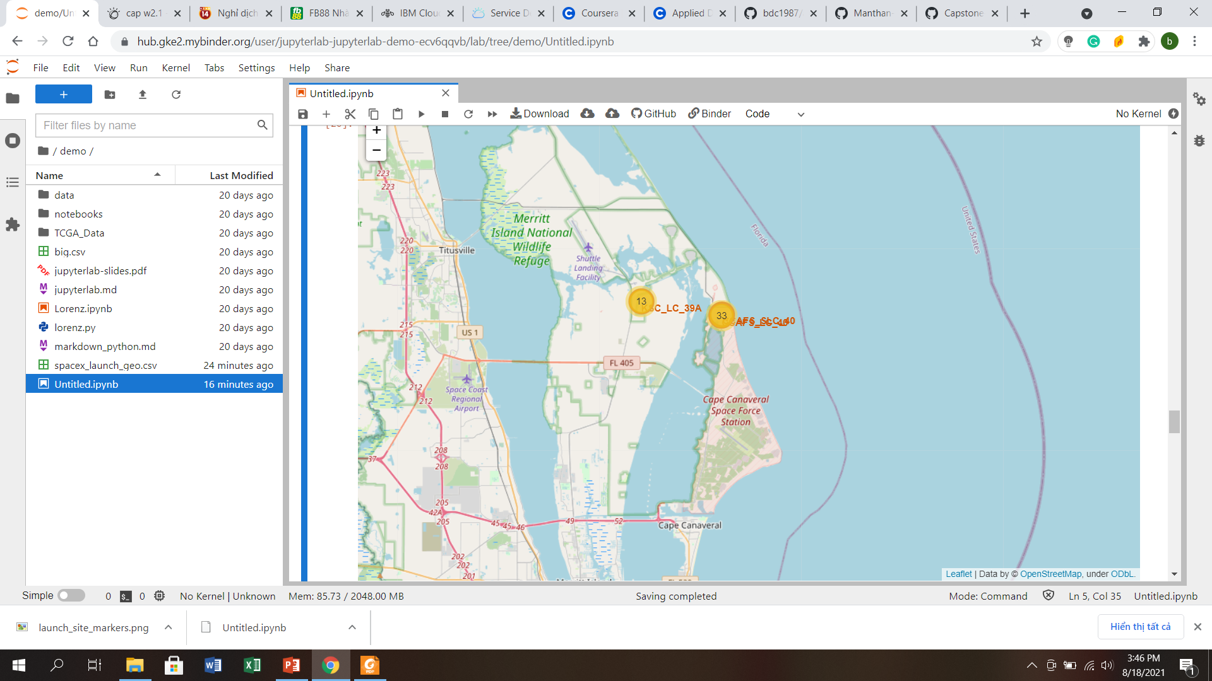
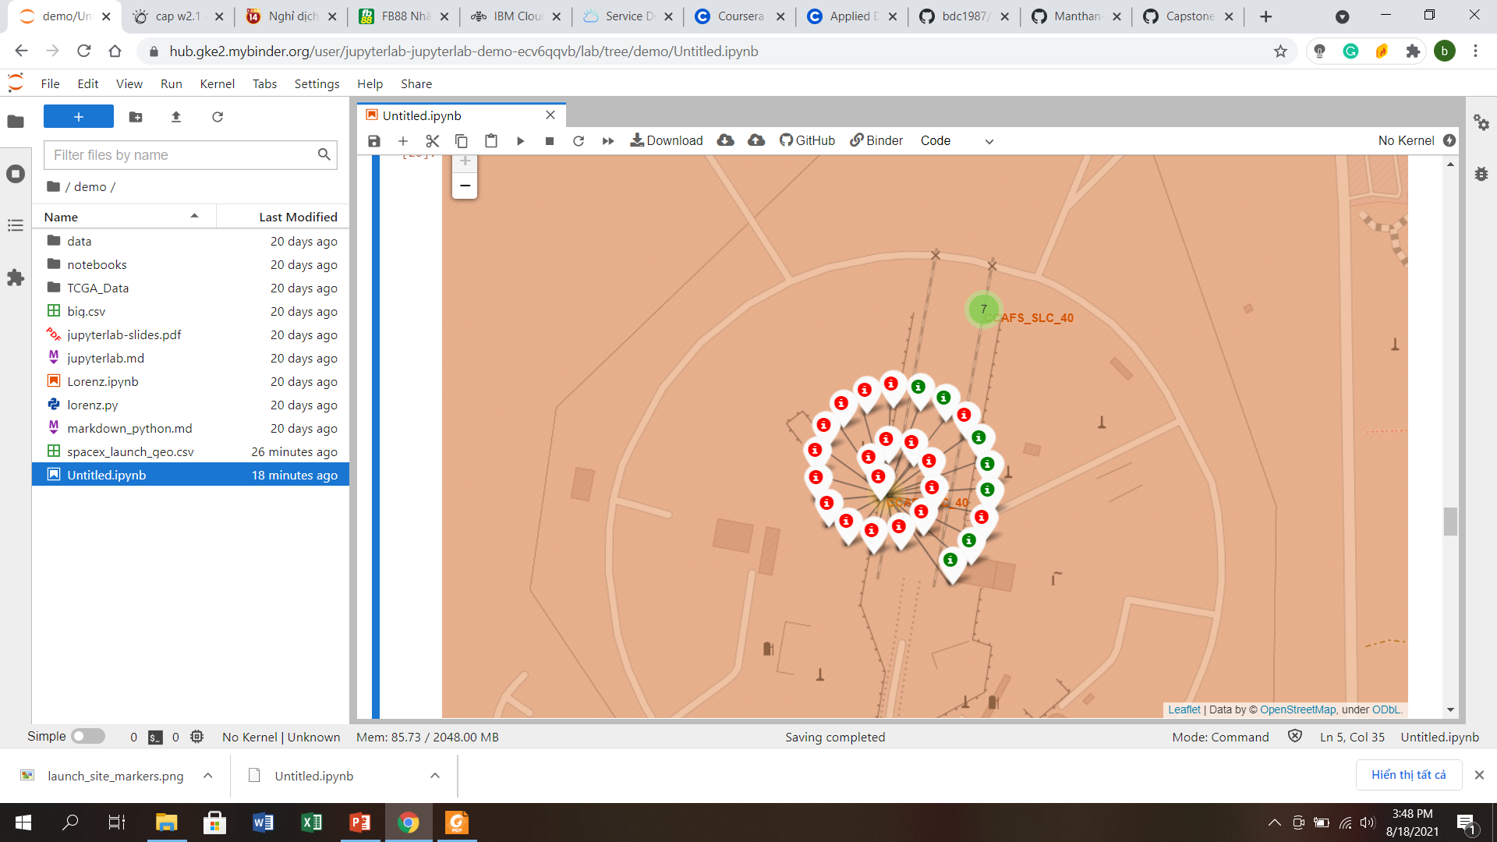
Success/ Failure launches for each site
Easily see of total launches of each site in first map
When clicking in a certain site we have second map, we will have better idea of success and failure launches for that specific site nearly (with green marker is success launches and red marker is failure launches)

Slide 37
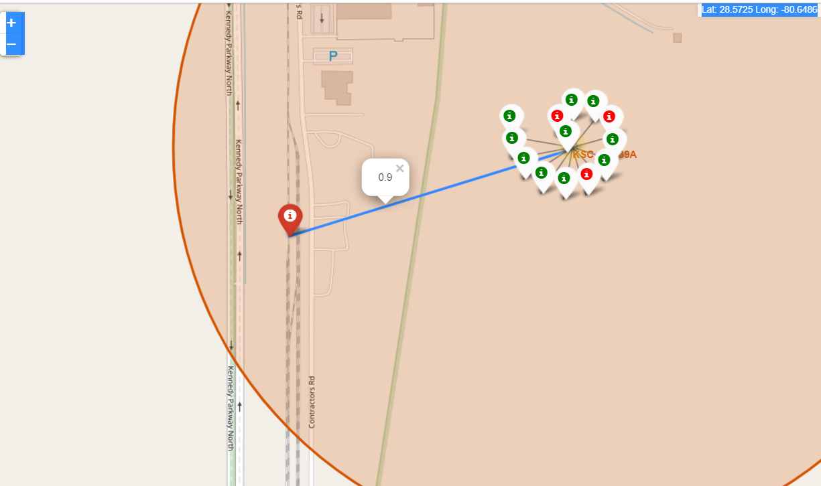
Distance between launch site and its proximities
Proximities are important to each site since it show the convenience of that facilities and give us better idea about that location
Also, extract distance shown in map enhances our knowledge of that location more than just visually

Slide 38
Build a Dashboard with Plotly Dash

Slide 39
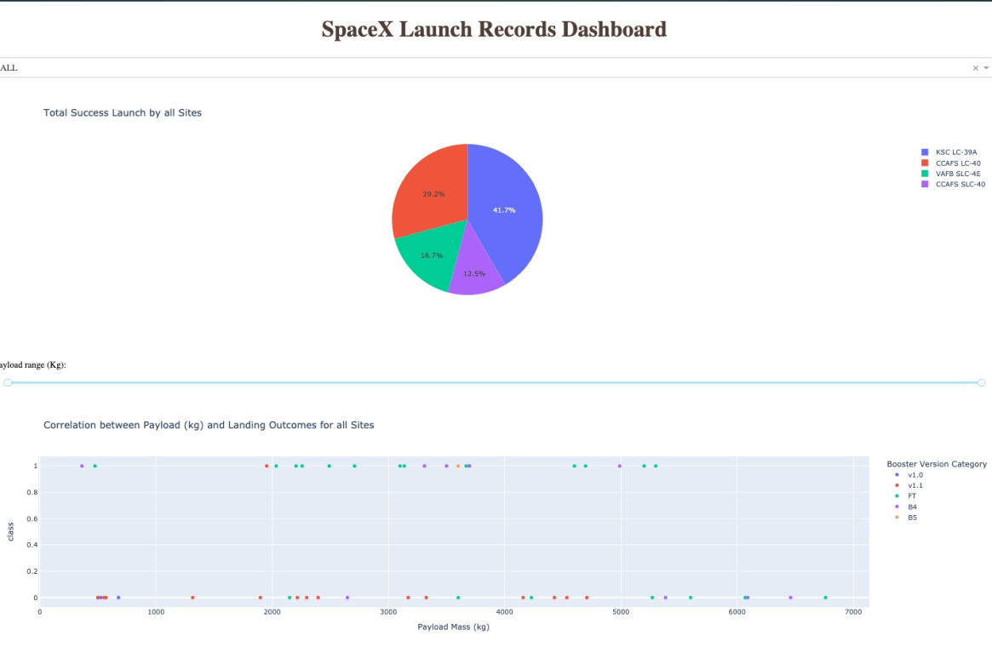
Overview of Dashboard by default option

Slide 40
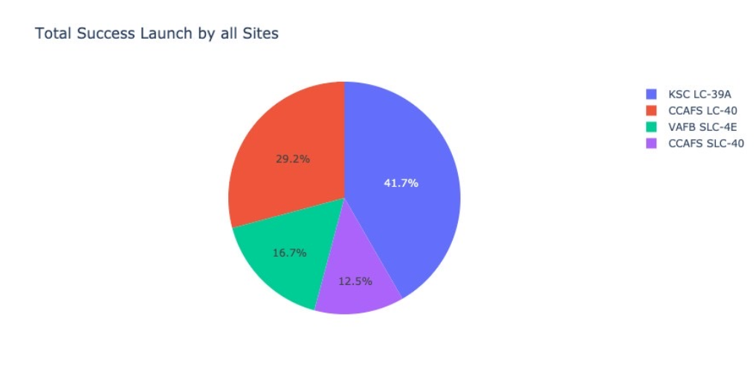
Total success Launch by all Sites
Pie chart beside shows us total successful launches, which site had best results, how was it compared to other sites.

Slide 41
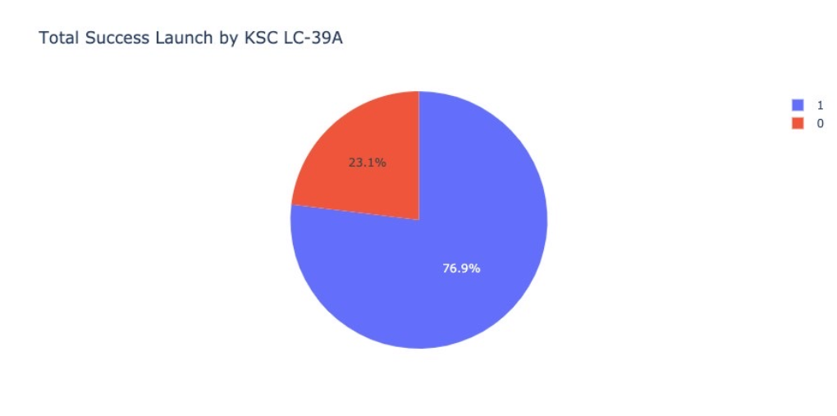
Success and Failure of site with highest ratio of success
Pie chart can show ratio of success for each site via option in drop down
All of site have high ratio of success and we can easily to switch charts between all sites

Slide 42
Predictive analysis (Classification)

Slide 43
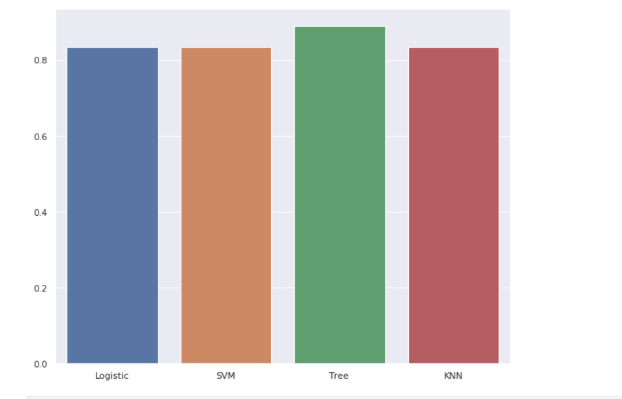
Classification Accuracy
It appears that Tree model classification has the best perform in train dataset. So, we should decide to further with Tree model.

Slide 44
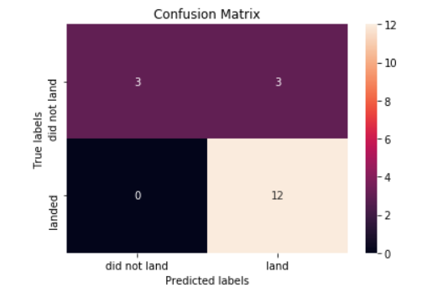
Confusion Matrix
Beside is confusion matrix of Tree model
We have test set of 18 samples:
Our model predicted correctly for all “Did not land” launches
It predicted correctly for 12 landed launches, and faultly for 3 launches which were in fact did not land

Slide 45

CONCLUSION
All sites have success rate not too different
Success rate is overally increasing over years and may have high correlation with payload mass
Tree model was chosen as predictive model classification with accuracy point highest
We may need to have more data to have better model train since the number of sample is still very few.

Slide 46

APPENDIX
Github for all notebooks:
https://github.com/bdc1987/appiled-data-science-capstone.git

